Slide 1
Telephones and postcards
Our brave new world of messaging
Jimmy Bogard
@jbogard
jimmybogard.lostechies.com

Slide 2
DISCLAIMER
Notes:
There’s nothing new about messaging. As long as humans have been able to speak, and then write, humans have used messaging to solve problems.
We just need to embrace it!

Slide 3
Styles

Slide 4
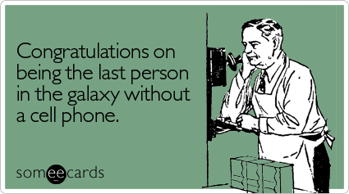
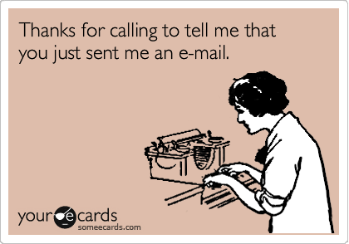
Sync & async
Notes:
Phone & mail

Slide 5


Durable & non-durable
Notes:
Verbal and written

Slide 6
Patterns

Slide 7
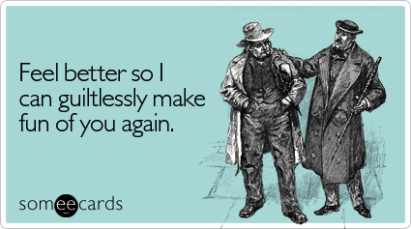

One-way & Request-reply

Slide 8


Publish-subscribe

Slide 9


Commands & events

Slide 10
Messaging IRL

Slide 11
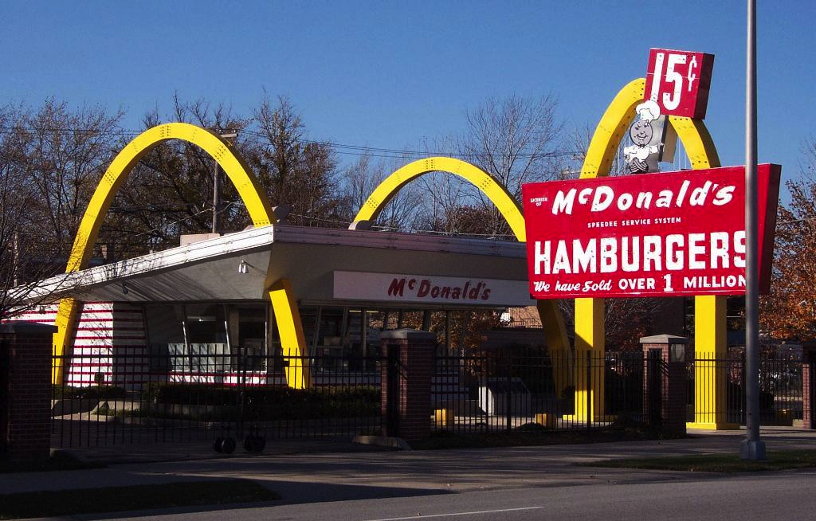
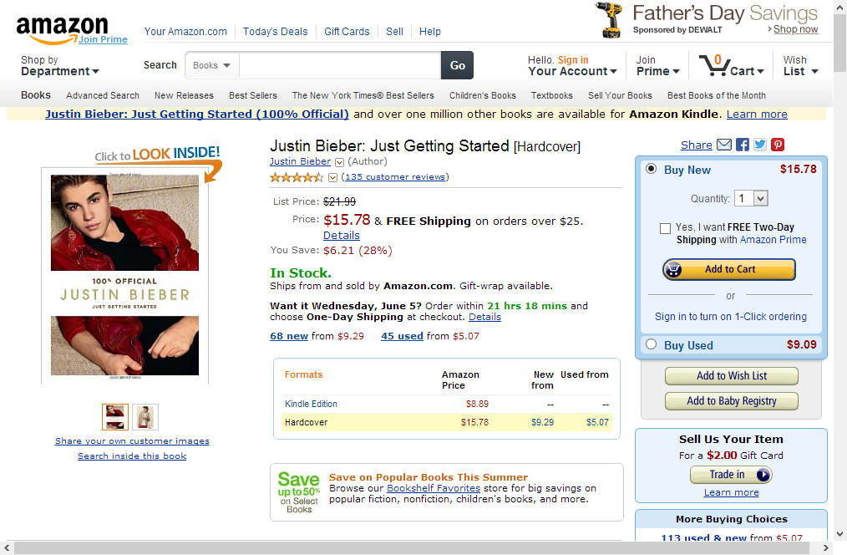


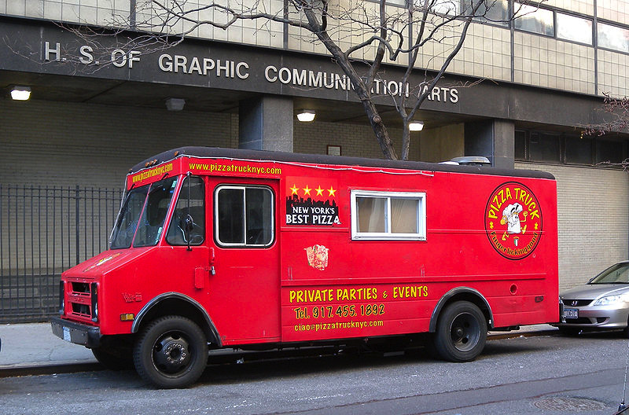
Scaling reality

Slide 12
Starting small
Everything done by one person
Everything synchronous
Everything in-process
Dress
Grill
Pack
Menu

Slide 13
Sound familiar?
UI
BLL
DAL
DB
Notes:
Every request synchronous to the browser

Slide 14
Business model
Take order – 30 seconds
Dress – 10 seconds
Grill – 100 seconds
Pack – 10 seconds
Total time: 150 seconds
Max orders per hour: 24
Dress
Grill
Pack
Menu

Slide 15
Further complications
People don’t like to wait
Long lines = people walk away
Can’t assume constant rate of flow
30 per hour does not imply 1 person every 2 minutes
Dress
Grill
HALP
Pack
Menu
wtf is going on in there

Slide 16
Solution: Hire more workers!
Each person does 1 job
Some can start several items in parallel
Ordering the only bottleneck now
Max orders per hour: 120
Dress
Grill
Pack
Menu

Slide 17
Problem: How do we fulfill an order?
Transaction no longer synchronous
How do later steps know what to do?
How do we know when we’re done?
Solution: messaging
Dress
Grill
Pack
Menu

Slide 18
First interaction: placing order
Information needed from customer: what food you want
Need to know how to notify customer that order is ready
Synchronous – Cashier and customer blocked during interaction
Non-durable – order is requested verbally
Dress
Grill
Pack
Menu

Slide 19
First interaction: placing order
POST /order
{
“name” : “Jimmy”
“item” : “Taco”
}
HTTP/1.0 201 Created
Location: /order/23
Dress
Grill
Pack
Menu

Slide 20
Next interactions: how to manage?
Durable or non-durable?
Who manages the steps?
How do we manage failures?
Dress
Grill
Pack
Menu

Slide 21
Order flow
SEND Dress
{
“Order”: “/order/23”
“Steps”: [“Dress”,
“Grill”,
“Pack”]
}
Dress
Grill
Pack
Menu

Slide 22
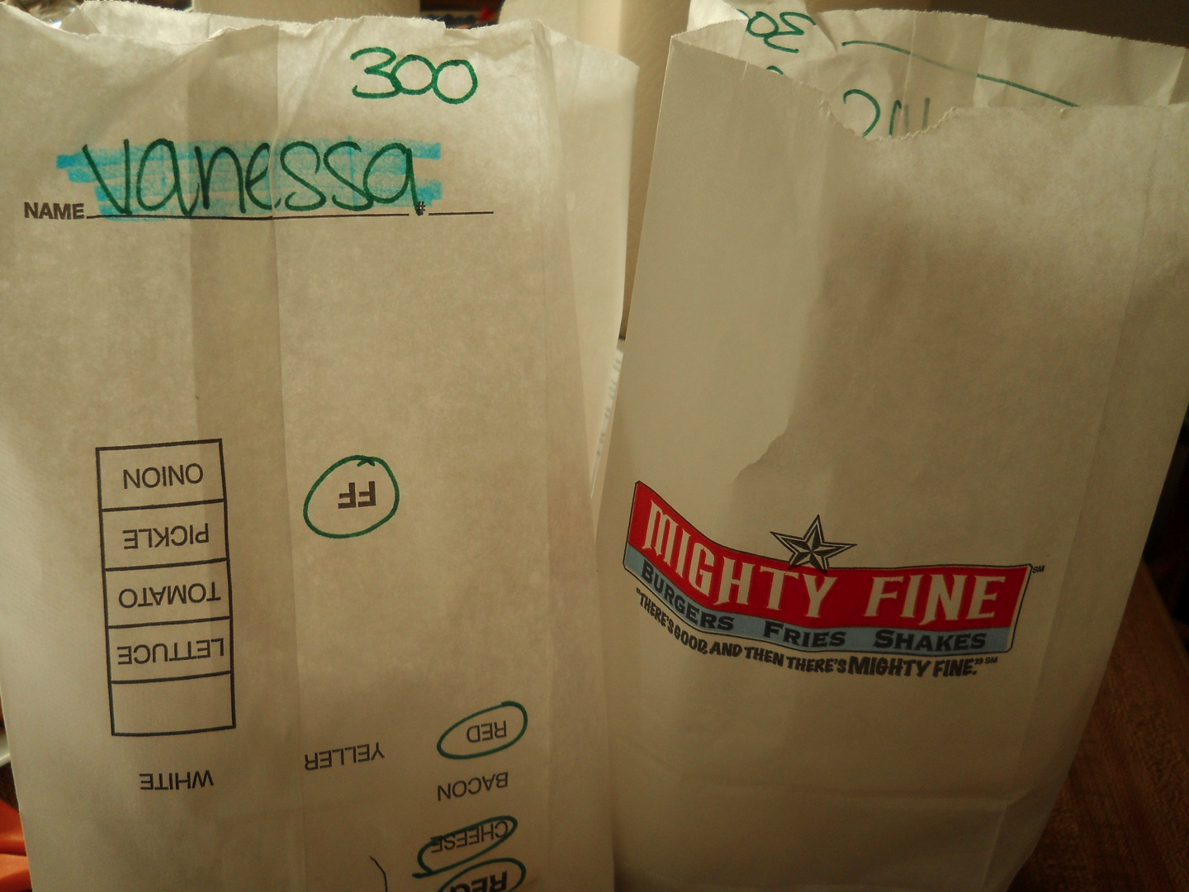
Order flow
Dress
Grill
Pack
Menu

Slide 23
Managing backlogs of work
Queues for each step
Asynchronous, durable messages allow temporal decoupling
Independence maintained
Dress
Grill
Pack
Menu

Slide 24
Getting faster
Notification of new order before order is accepted
Failure is a special case
Compensate accordingly
Non-durable asynchronous message to highlight uncertainty
Dress
Grill
Pack
Menu

Slide 25
What about our reads?

Slide 26
Catalogs and menus
Reading menu is cheap
Menu built for customers
Decisions on building menu not visible to customers
Dress
Grill
Pack
Menu

Slide 27


Creating the menu
Optimized for managing the menu
Decisions and business rules
Calculations and forecasts
Historical trends

Slide 28
Typical solution
Front end
Back
end
DB

Slide 29
Equivalent design
Same model to solve two very different problems
Two very different characteristics
Want two different solutions
Dress
Grill
Pack
wtf is going on in there

Slide 30
Better solution
Front end
Back
end
DB
DB
?

Slide 31
Interactions
Updating menu on a scheduled basis
Menu is immutable
Data is duplicated but ownership preserved
Dress
Grill
Pack
Menu

Slide 32
Publishing changes
PUBLISH MenuUpdated
{
“Date”: “2013-09-01”,
“Items”: [
{ “Name”: “Taco”,
“Price”: 1.49 },
…
]
}
Dress
Grill
Pack
Menu

Slide 33
Multiple subscribers
Store A
Publisher keeps track of subscribers
Durable format
Publishing creates message per subscriber
Store B
Stores
…
…
Store C

Slide 34
Characteristics
Store A
Durable message to subscribers
Subscribers unaware of each other
If one store is closed, other menus continue to be updated
Store B
Stores
…
…
Store C

Slide 35
Parting thoughts
Constraints of real world haven’t changed – the latency is just shorter
Solutions from real world apply directly to a distributed world
Real world solved distribution problems with messaging
And so can you!

